Slide 1

AJAX
Asst.Prof.Dr.Derya BİRANT
328 - Web Based Windows Programming

Slide 2
Outline
1
AJAX Technique
2
Javascript vs. AJAX
3
Advantages of AJAX
4
ASP.NET AJAX Controls
5
Examples with and without AJAX

Slide 3
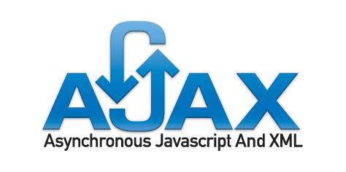
AJAX
AJAX was originally shorthand for
Asynchronous JavaScript and XML.

Slide 4
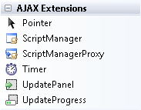
ASP.NET AJAX History
AJAX published in February 2005.
ASP.NET 2.0 AJAX Extensions 1.0
A library of client-side scripts and a half dozen core controls to place onto an ASP.NET page
ASP.NET AJAX Control Toolkit
A library of almost three dozen server-side controls which demonstrate how to use and extend ASP.NET AJAX 1.0
ASP.NET AJAX Futures
Early developer releases of ASP.NET AJAX 2.0.
ASP.NET AJAX 3.5 (included with ASP.NET 3.5)
Visual Studio 2008 incorporates support for ASP.NET-enabled web-sites.
ASP.NET AJAX 4.0 (included with ASP.NET 4.0)
http://www.asp.net/ajax

Slide 5

AJAX Technique
Problem:
  The PostBack architecture has its weaknesses.
  Because posting back the page always involves some small but noticeable overhead.
Solution:
  Refresh a portion of the page, all without triggering a full-page postback.
  The CallBack architecture to make more responsive pages.
  The advantages are greater responsiveness and a seamless browsing experience that’s free of page refreshes.
Notes:
Asenkron olarak JavaScript + XML'i kullanır

Slide 6
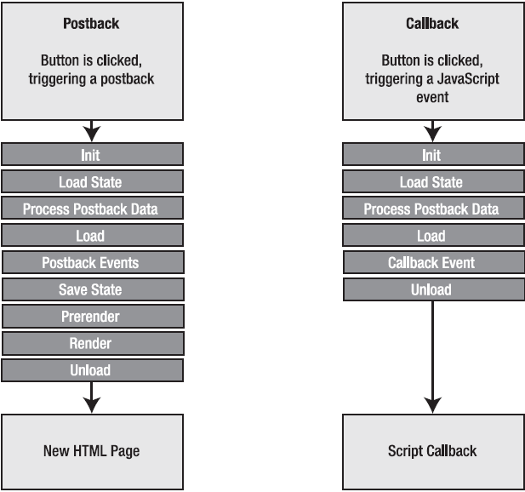
Comparing Postbacks and Callbacks

Slide 7
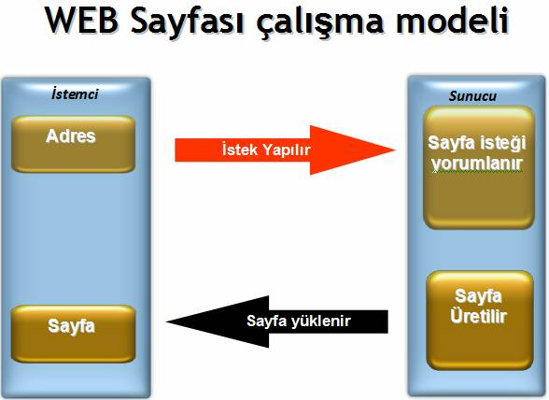
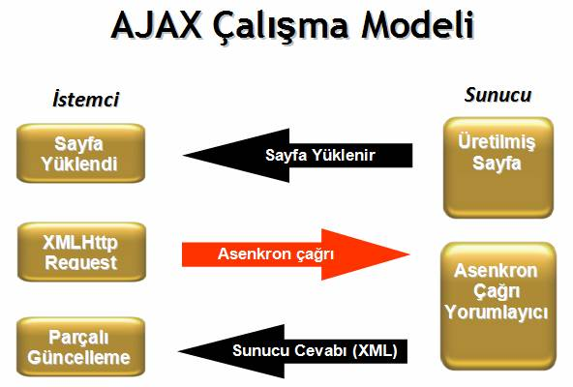
With and Without AJAX

Slide 8
Example Websites
Example websites that use AJAX technique
  Gmail
  Google Map
  Google Suggest
  Live mail
  Orkut (Social networking and discussion site operated by Google)
  A9.com Search Engine (Amazon)
  Fickr
  ...
Notes:
Google Ajax yaklaşımının gelişmesi için büyük yatırımlar yaptı. Google'ın geçen yıl tanıttığı önemli ürünlerin hepsi,Orkut,Gmail, Google Groups, Google Suggest ve Google Maps, ajax yaklaşımı kullanılarak geliştirilmiştir.

Slide 9
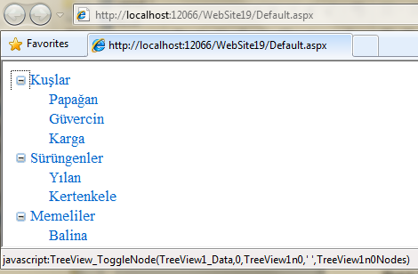
Javascript
JavaScript is an embedded language.
The code is downloaded to the client computer and executed by the browser.
One of the main reasons developers use JavaScript code is to avoid a postback.
For Example: Consider TreeView control → When you expand a node, the TreeView uses JavaScript to show the new nodes.
Without JavaScript, the page would need to be posted back so the TreeView could be rebuilt. The user would notice a slightly sluggish delay.

Slide 10
Javascript vs. AJAX
Most of the JavaScript examples doesn’t require interaction with the rest of the page model.
  For example, showing a pop-up message don’t need to interact with the server-side code.
However, if you want to make a truly dynamic page like in the TreeView example, one that can call a server-side method, wait for a response, and insert the new information dynamically, without triggering a full-page postback?
To design this solution, you need to think of a way for your client-side script to communicate with your server-side code.
AJAX-style pages communicate with the server in the background to request additional information.
When the client-side code receives this information (which may be transmitted as an XML package), it carries out additional actions, all without triggering a full-page postback.
Furthermore, the communication between the client and server happens asynchronously, so the client isn’t interrupted.
Notes:
asekron

Slide 11
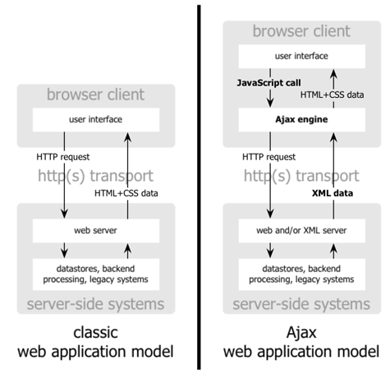
AJAX Technique

Slide 12
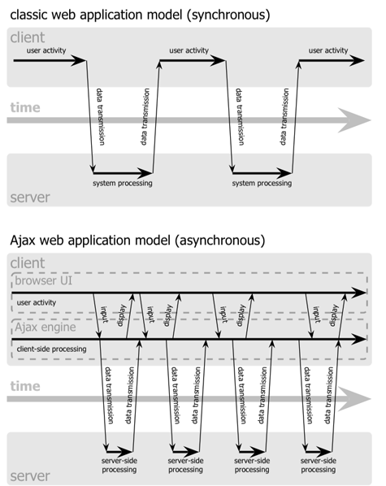
With and Without AJAX

Slide 13
Advantages of AJAX
Asynchronous calls — AJAX allows for the ability to make asynchronous calls to a web server. This allows the client browser to avoid waiting for all data to arrive before allowing the user to act once more.
Minimal data transfer — By not performing a full postback and sending all form data to the server, network utilization is minimized and quicker operations occur. This can greatly improve network performance.
Limited processing on the server — The server is not required to process all form elements. By sending only the necessary data, there is limited processing on the server.
Responsiveness — Because AJAX applications are asynchronous on the client, they are perceived to be very responsive. It eliminates the page refresh problem and slow response
Context — With a full postback, users may lose the context of where they are. With AJAX there is no full postback. AJAX will allow users to maintain their location.
Free Toolkits and Libraries – A large number of AJAX toolkits and libraries are available for free.

Slide 14
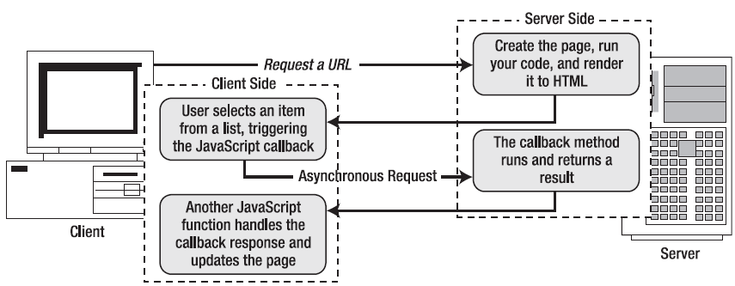
AJAX Technique

Slide 15
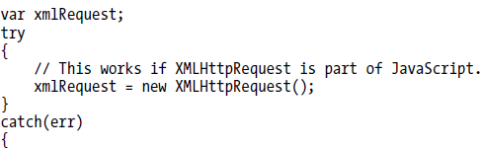

The XMLHttpRequest Object
XMLHttpRequest allows you to send requests to the server asynchronously and retrieve the results as text.
Although there is wide support for the XMLHttpRequest object in modern browsers, there’s a subtle difference in how you access the object.
  In some browsers, including Internet Explorer 7, Firefox, Safari, and Opera, the XMLHttpRequest object is implemented as a native JavaScript object.
  In versions of Internet Explorer before version 7, it’s implemented as an ActiveX object.

Slide 16
The XMLHttpRequest Object
To send a request: open() and send().
  xmlRequest.open("GET" , myURL);
  xmlRequest.send(null);
To handling response:
  xmlRequest.onreadystatechange = UpdatePage;

Slide 17

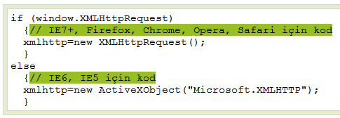
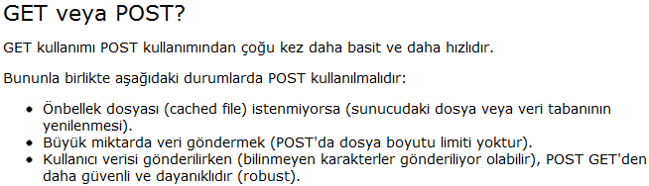

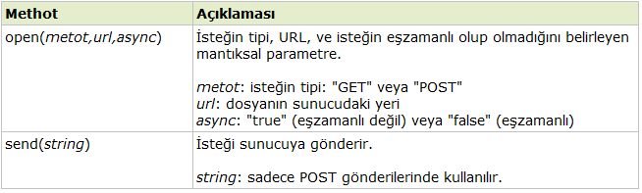


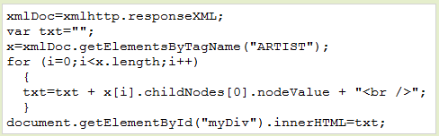
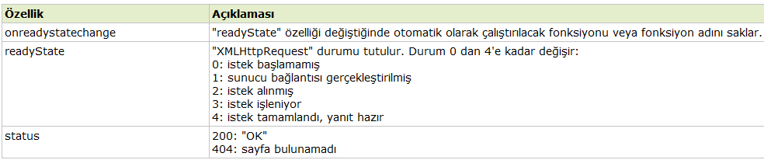
The XMLHttpRequest Object
XMLHttpRequest nesnesi yaratmak
Sunucuya isteği göndermek
ajax_info.ashx
Sunucudan yanıtı almak
Label1
Notes:
responseText → sunucudan yanıtı dizgi olarak almak
responseXML → sunucudan yanıtı XML formatında almak.

Slide 18
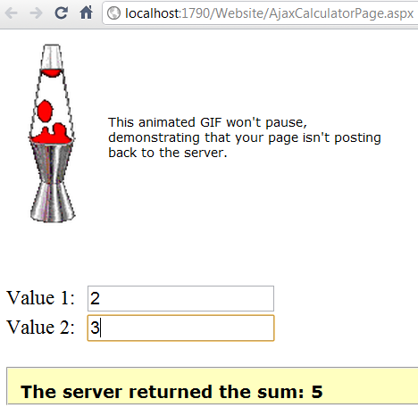
<head runat="server">
<script type="text/javascript">
var xmlRequest;
function CreateXMLHttpRequest()
{
try
{
// This works if XMLHttpRequest is part of JavaScript.
xmlRequest = new XMLHttpRequest();
}
catch(err)
{
// Otherwise, the ActiveX object is required.
xmlRequest = new ActiveXObject("Microsoft.XMLHTTP");
}
}
function CallServerForUpdate()
{
var txt1 = document.getElementById("TextBox1");
var txt2 = document.getElementById("TextBox2");
var url = "CalculatorCallbackHandler.ashx?value1=" +
txt1.value + "&value2=" + txt2.value;
xmlRequest.open("GET", url);
xmlRequest.onreadystatechange = ApplyUpdate;
xmlRequest.send(null);
}
function ApplyUpdate()
{ // Check that the response was received successfully.
if (xmlRequest.readyState == 4)
{
if (xmlRequest.status == 200)
{
document.getElementById("Label1").innerHTML = "The server returned the sum: " + xmlRequest.responseText;
}
}
}
</script> </head>
<body onload="CreateXMLHttpRequest();">
Client Side Code
CalculatorCallbackHandler.ashx
Server Side Code
using System;
using System.Web;
public class CalculatorCallbackHandler : IHttpHandler
{
public void ProcessRequest (HttpContext context)
{
HttpResponse response = context.Response;
// Write ordinary text.
response.ContentType = "text/plain";
// Get the query string arguments.
float value1, value2;
if (Single.TryParse(context.Request.QueryString["value1"], out value1) &&
Single.TryParse(context.Request.QueryString["value2"], out value2))
{
response.Write(value1 + value2);
}
}
public bool IsReusable
{
get
{
return true;
}
}
}
<asp:TextBox ID="TextBox1" runat="server"></asp:TextBox>
<asp:TextBox ID="TextBox2" runat="server" onKeyUp="CallServerForUpdate();"></asp:TextBox>
<asp:Label ID="Label1" runat="server"></asp:Label>
Notes:
Ashx: Generic handler dosyalarıdır. Bunlar genellikle Ajax işlemleri yaparken kullanılır. Web sayfası içeriğini okumaya ve sayfaya cevap göndermeye yarar.
Aspx,Ascx yapılarında olduğu gibi HTML içeriğine sahip değildirler.
Asp.Net projelerinde sayfanın döndüreceği değer dinamik olarak resim, excel, word, xml gibi binary(ikili) şekilde olacaksa en verimli kullanım ashx uzantılı dosyaları ile sağlanır.

Slide 19
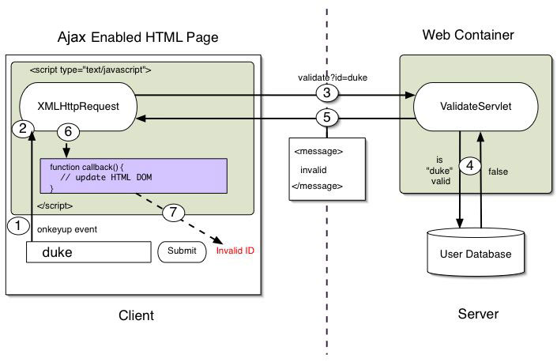
AJAX Technique

Slide 20

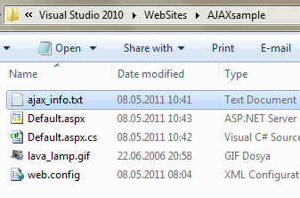
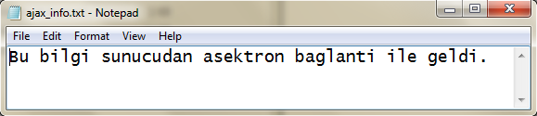
AJAX Sample (Step 1)
Drag and Drop a Label and a Button
Write OnClientClick to Button
Create a text document ajax_info.txt and save in project folder

Slide 21
AJAX Sample (Step 2)
Open Source View and write script
AJAX Sample (Step 2)
<head runat="server">
<title></title>
<script type="text/javascript">
var xmlRequest;
function CreateXMLHttpRequest() {
try {
// This works if XMLHttpRequest is part of JavaScript.
xmlRequest = new XMLHttpRequest();
}
catch (err) {
// Otherwise, the ActiveX object is required.
xmlRequest = new ActiveXObject("Microsoft.XMLHTTP");
}
}
function myfunction() {
xmlRequest.open("GET","ajax_info.txt", true);
xmlRequest.onreadystatechange = myfunction2;
xmlRequest.send(null);
}
function myfunction2() {
if (xmlRequest.readyState == 4) {
if (xmlRequest.status == 200) {
document.getElementById("Label1").innerHTML = xmlRequest.responseText;
}
}
}
</script>
</head>
<body onload="CreateXMLHttpRequest();">

Slide 22
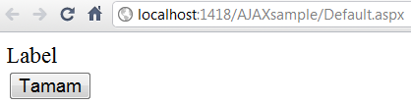
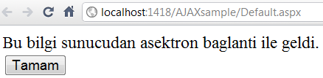
Run the program
We get the information from server without refreshing whole webpage
AJAX Sample (Step 3)

Slide 23
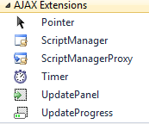
ASP.NET AJAX Controls
Script Manager (Betik Yönerge Yöneticisi)
  Ajax script kütüphanelerini ve script dosyalarını yönetir.
  Ajax bileşeni kullanacagımız her sayfaya bu kontrolü eklemeliyiz.
ScriptManagerProxy (Betik Yönerge Yöneticisi Vekili)
  Eğer master page içinde ScriptManager tanımlanmışsa master page üzerinden türetilmiş sayfalarda ScriptManagerProxy tanımlanmalıdır.
Timer (Zamanlayıcı)
  Belirli zaman aralıklarında client-tabanlı olayları gerçekleştirmek için kullanılır.
  UpdatePanel içinde kullanılır.
  OnTick ile her tick için yapılması gereken event tanımlanabilir.
  Interval özelliği için 1000 = 1 sn demektir.
Update Panel (Güncelleme Paneli)
  Sayfa da postback islemi olmadan sadece update panel içerisindeki veri güncellenir.
Update Progress (Güncelleme İlerleyişi)
  UpdatePanel güncellendiginde yada içerik değiştiğinde browser da kullancıyı bilgilendirme amaçlı kullandığımız kontroldür.
  Uzun süren işlemlerde kullanmak mantıklıdır. Yazı, hareketli bir resim gibi

Slide 24
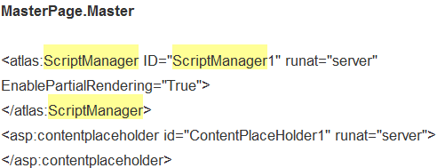
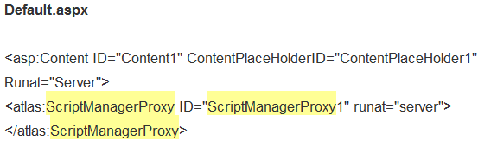
ScriptManagerProxy Control
Hem master sayfanızda hem de içerik sayfasında scriptmanager kullanırsak hata alırız.
Eğer master page içinde ScriptManager tanımlanmışsa master page üzerinden türetilmiş sayfalarda ScriptManagerProxy tanımlanmalıdır.

Slide 25
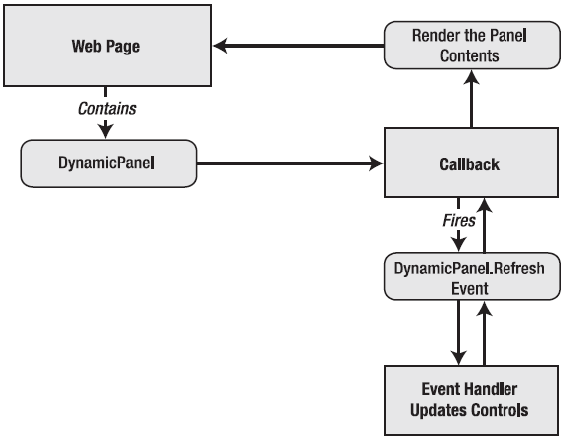
Panel Usage
You can use a panel that contains content that you want to refresh.

Slide 26
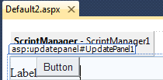
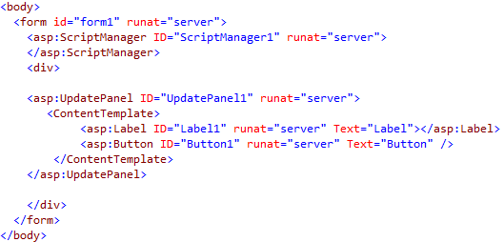


Example Update Panel
Drag and drop ScriptManager
Drag and drop Update Panel
Drag and drop a Label and a Button into UpdatePanel
Write code into Page_Load
Run the program
protected void Page_Load(object sender, EventArgs e)
{
Label1.Text = DateTime.Now.ToLongTimeString();
}

Slide 27
Update Panel
The user clicks a button inside an UpdatePanel.
Performs an asynchronous callback to the server.
On the server, a code is executed, with all the usual events.
Finally, the page is rendered to HTML and returned to the browser.
The client-side JavaScript code receives the full HTML and updates every UpdatePanel on the page by replacing its current HTML with the new content.

Slide 28
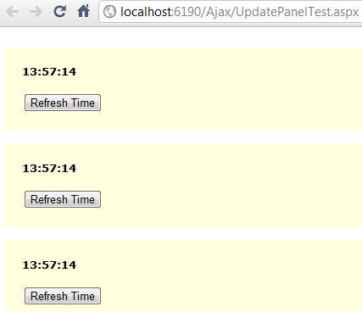
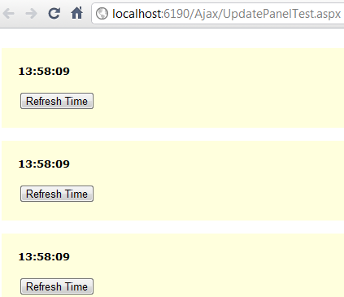
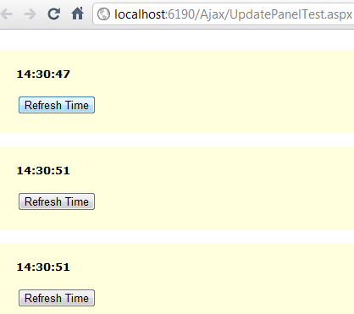
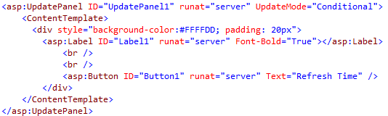
UpdateMode of Update Panel
UpdateMode = "Always" (Default)
  Sayfa içerisindeki herhangi bir UpdatePanel'in tetiklenmesi, panelin de tetiklenmesini sağlamaktadır.
UpdateMode = "Conditional"
  Panel sadece kendi tetikleyicileri aracılığıyla tetiklenmektedir.
"Always"
"Conditional"

Slide 29
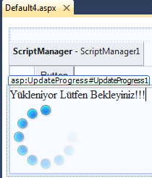
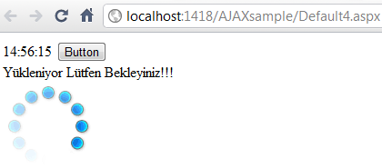
UpdateProgress Control
UpdatePanel yenilenmeye çalışılırken yükleme mesajlarının verilebilmesini sağlayan bileşendir.
ScriptManager, UpdatePanel (Label + Button)
içeren sayfaya UpdateProgress sürüklenir.
UpdateProgress içersine animated bir resim konulur.
Program çalıştırılır.
<asp:UpdateProgress ID="UpdateProgress1" runat="server">
<ProgressTemplate>
Yükleniyor Lütfen Bekleyiniz!!!<br />
<asp:Image ID="Image1" runat="server"
ImageUrl="~/8-1.gif" />
</ProgressTemplate>
</asp:UpdateProgress>
Tasarım Aşaması
protected void Page_Load(object sender, EventArgs e)
{
Label1.Text = DateTime.Now.ToLongTimeString();
}
Program çalışırken

Slide 30
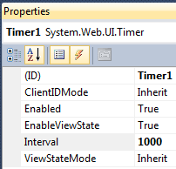
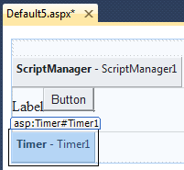
Timer Control
Timer ile sürekli tetiklenme sağlanabilmekte ve böylece veriler (bilgiler) belirli zaman aralıklarında sürekli yenilenebilmektedir.
ScriptManager, UpdatePanel (Label + Button) içeren sayfaya Timer sürüklenir.
Timer interval 1000 (1sn.) yapılır.
Program çalıştırılır.
<asp:ScriptManager ID="ScriptManager1" runat="server">
</asp:ScriptManager>
<asp:UpdatePanel ID="UpdatePanel1" runat="server">
<Triggers>
<asp:AsyncPostBackTrigger ControlID="Timer1" />
</Triggers>
<ContentTemplate>
<asp:Label ID="Label1" runat="server" Text="Label"></asp:Label>
<asp:Button ID="Button1" runat="server" Text="Button" />
</ContentTemplate>
</asp:UpdatePanel>
<asp:Timer ID="Timer1" runat="server" Interval="1000">
</asp:Timer>
protected void Page_Load(object sender, EventArgs e)
{
Label1.Text = DateTime.Now.ToString();
}

Slide 31
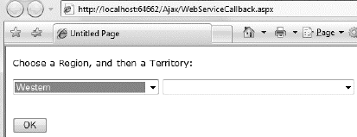
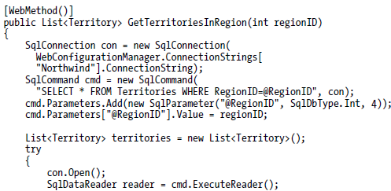



Web Services in ASP.NET AJAX
Your client-side JavaScript code can call a method in a server-side web service.
Web Service
Calling the Web Service

Slide 32
ASP.NET AJAX Control Toolkit
One example is the free third-party Ajax.NET library, which is available at
http://www.asp.net/ajaxlibrary/act.ashx
Ajax.NET uses attributes to flag methods, which then become remotely callable through a client callback and a custom HTTP handler.

Slide 33
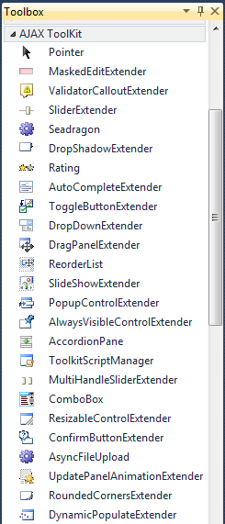
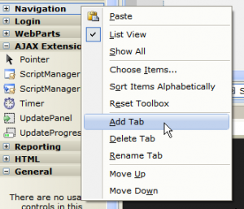
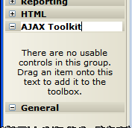
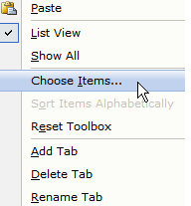
AJAX Control Toolkit
Right-click the Toolbox and choose Add Tab. Then, enter a name (like AJAX Toolkit) and press Enter.
Right-click the blank tab you’ve created and select Choose Items.
First, begin by adding the ScriptManager control to the web page, then use these components.
Click Browse, find the
AjaxControlToolkit.dll and click OK

Slide 34
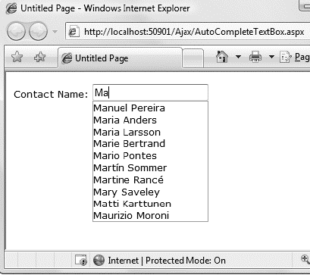
AJAX Control Toolkit
First, begin by adding the ScriptManager control to the web page, then use the components.
For example, providing an autocomplete list of names.

Slide 35

See you next week!
Asst.Prof.Dr.Derya BİRANT
328 - Web Based Windows Programming

